Slide 1
CSC 2105::Data Structure Graph
Mashiour Rahman
Senior Assistant Professor, Department of Computer Science
Director, Faculty of Science & Information Technology
American International University-Bangladesh (AIUB)
mashiour@aiub.edu

Slide 2
Motivation
State-space search in Artificial Intelligence
Geographical information systems, electronic street directory
Logistics and supply chain management
Telecommunications network design
Many more industry applications

Slide 3
Graph Introduction
Graph G = (V, E)
V = {1,…n} = set of vertices, E = set of e edges, | E | = total edges, | V | = total vertex.
Undirected graph:
edge (u, v) = edge (v, u)
no self-loops
Directed graph (digraph):
edge (u, v) goes from vertex u to vertex v
Sparse graph:
e = O(n), dense otherwise
Degree of a vertex v:
degree(v) = number of edges adjacent on v (in-degree and out-degree for directed graphs)

Slide 4
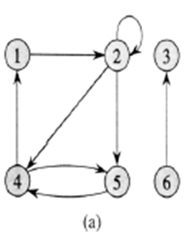
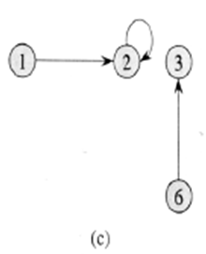
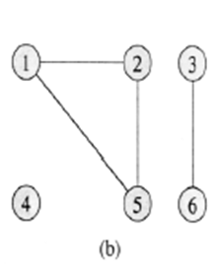
Examples of Graph
The subgraph of the graph in part (a) induced by vertex set {1, 2, 3, 6}.
An undirected graph G = (V, E), where V = {1, 2, 3, 4, 5, 6} and E = { (1,2), (1,5), (2,5), (3,6) }. The vertex 4 is isolated. Vertex 1, 2, 3 has degree 2; vertex 3, 6 has degree 1; vertex 4 has degree 0. Vertex 3 is adjacent to vertex 6 and vice versa; {1, 5} is adjacent to 2; 4 is not adjacent to any other vertex.
A directed graph G= (V, E), where V = {1, 2, 3, 4, 5, 6} and E={ (1,2), (2,2), (2,4), (2,5), (4,1), (4,5), (5,4), (3,6) }. The edge (2,2) is self loop. Vertex 5 has in-degree 2 and out-degree 1. Vertex 4 is adjacent to vertex 5; {1, 5} is adjacent to 4; 3 is not adjacent to any other vertex.

Slide 5
…Graphs
Weighted graph: associates weights with either the edges or the vertices
Acyclic: if a graph contains no cycles
DAG: Directed acyclic graphs
Connected: if every vertex of a graph can reach every other vertex, i.e., every pair of vertices is connected by a path
Connected Components: equivalence classes of vertices under “is reachable from” relation
Strongly connected: every 2 vertices are reachable from each other (in a digraph)

Slide 6
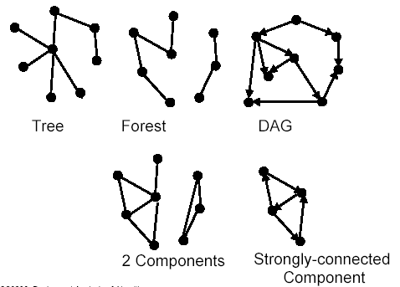
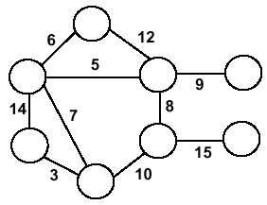
Forests, DAG, Components
Weighted Graph

Slide 7
Graph Applications
The graphic representation of world wide web (www)
Resource allocation graph for processes that are active in the system.
The graphic representation of a map
Scene graphs: The contents of a visual scene are also managed by using graph data structure.

Slide 8
Applications—Communication Network
2
3
8
1
10
4
5
9
11
6
7
Vertex = city, edge = communication link.

Slide 9
Applications—Driving Distance/Time Map
2
4
3
8
8
1
6
10
2
4
5
4
4
3
5
9
11
5
6
6
7
7
Vertex = city, edge weight = driving distance/time.

Slide 10
Applications—Street Map
2
3
8
1
10
4
5
9
11
6
7
Some streets are one way.

Slide 11
Graph Representation
Adjacency matrix: represents a graph as n x n matrix A:
A[i, j] = 1 if edge (i, j) ∈ E (or weight of edge)
= 0 if edge (i, j) ∉ E
Storage requirements: O(n²)
A dense representation
But, can be very efficient for small graphs
Especially if store just one bit/edge
Undirected graph: only need half of matrix
Adjacency list: list of adjacent vertices
For each vertex v ∈ V, store a list of vertices adjacent to v
Storage requirements: O(n+e)
Good for large, sparse graphs (e.g., planar maps)

Slide 12
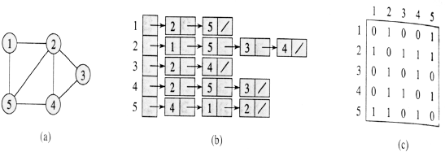
Representing Graph
Two representations of an undirected graph.
An undirected graph G having five vertices and seven edges.
An adjacency-list representation of G.
The adjacency-matrix representation of G.
Details in the next Laboratory.

Slide 13
Graph Searching/Traversing
Given: a graph G = (V, E), directed or undirected
Goal: methodically explore every vertex and edge
Ultimately: build a tree on the graph
Pick a vertex as the root
Choose certain edges to produce a tree
Note: might also build a forest if graph is not connected
Many graph problems solved using a search method.
Path from one vertex to another.
Is the graph connected?
Find a spanning tree.
Etc.
Commonly used search methods:
Breadth-first search
Depth-first search
Other variants: best-first, iterated deepening search, etc.

Slide 14
Depth-First Search (DFS)
Explore “deeper” in the graph whenever possible
Edges are explored/visited out of the most recently discovered vertex v that still has unexplored/unvisited edges (LIFO)
When all of v’s edges have been explored, backtrack to the vertex from which v was discovered.
computes 2 timestamps: d[ ] (discovered) and f[ ] (finished)
builds one or more depth-first tree(s) (depth-first forest)
Algorithm colors each vertex
WHITE: undiscovered
GRAY: discovered, in process
BLACK: finished, all adjacent vertices have been discovered

Slide 15
Depth-First Search: The Code
DFS( G ){
for each vertex u ∈ V
color[u] = WHITE;
time = 0;
for each vertex u ∈ V
if (color[u] == WHITE)
DFS_Visit( u );
}
DFS_Visit( u ){
color[u] = GREY;
time = time+1;
d[u] = time; // compute d[]
for each v adjacent to u
if (color[v] == WHITE)
p[v]= u // build tree
DFS_Visit(v);
color[u] = BLACK;
time = time+1;
f[u] = time; // compute f[]
}

Slide 16
DFS Example: Classification of Edges
DFS can be used to classify edges of G:
Tree edges: edges in the depth-first forest.
Back edges: edges (u, v) connecting a vertex u to an ancestor v in a depth-first tree.
Forward edges: non-tree edges (u, v) connecting a vertex u to a descendant v in a depth-first tree.
Cross edges: all other edges.
DFS yields valuable information about the structure of a graph.

Slide 17
DFS Example: Classification of Edges
u
v
w
Undiscovered
Discovered, On Process
Finished, all adjacent vertices have been discovered
x
y
z
Discover time/ Finish time

Slide 18
DFS Example: Classification of Edges
u
u
v
v
w
w
Undiscovered
1/
Discovered, On Process
Finished, all adjacent vertices have been discovered
x
x
y
y
z
z
Discover time/ Finish time

Slide 19
DFS Example: Classification of Edges
u
u
u
v
v
v
w
w
w
Undiscovered
1/
1/
2/
Discovered, On Process
Finished, all adjacent vertices have been discovered
x
y
z
x
x
y
y
z
z
Tree edge
Discover time/ Finish time

Slide 20
DFS Example: Classification of Edges
u
u
u
u
v
v
v
v
w
w
w
w
Undiscovered
1/
1/
1/
2/
2/
Discovered, On Process
Finished, all adjacent vertices have been discovered
3/
x
y
z
x
x
x
y
y
y
z
z
z
Tree edge
Discover time/ Finish time

Slide 21
DFS Example: Classification of Edges
u
u
u
u
u
v
v
v
v
v
w
w
w
w
w
Undiscovered
1/
1/
1/
1/
2/
2/
2/
Discovered, On Process
4/
3/
Finished, all adjacent vertices have been discovered
3/
x
y
z
x
x
x
x
y
y
y
y
z
z
z
z
Tree edge
Discover time/ Finish time

Slide 22
DFS Example: Classification of Edges
u
u
u
u
u
u
v
v
v
v
v
v
w
w
w
w
w
w
Undiscovered
1/
1/
1/
1/
1/
2/
2/
2/
2/
Discovered, On Process
4/
3/
4/
3/
Finished, all adjacent vertices have been discovered
3/
x
y
z
x
y
z
x
x
x
x
y
y
y
y
z
z
z
z
Tree edge
Back Edge
Discover time/ Finish time

Slide 23
DFS Example: Classification of Edges
u
u
u
u
u
u
u
v
v
v
v
v
v
v
w
w
w
w
w
w
w
Undiscovered
1/
1/
1/
1/
1/
1/
2/
2/
2/
2/
2/
Discovered, On Process
4/
3/
4/
4/5
3/
3/
Finished, all adjacent vertices have been discovered
3/
x
y
z
x
y
z
x
x
x
x
x
y
y
y
y
y
z
z
z
z
z
Tree edge
Back Edge
Discover time/ Finish time

Slide 24
DFS Example: Classification of Edges
u
u
u
u
u
u
u
u
v
v
v
v
v
v
v
v
w
w
w
w
w
w
w
w
Undiscovered
1/
1/
1/
1/
1/
1/
1/
2/
2/
2/
2/
2/
2/
Discovered, On Process
4/
3/
4/
4/5
4/5
3/
3/
3/
Finished, all adjacent vertices have been discovered
3/6
x
y
z
x
y
z
x
x
x
x
x
x
y
y
y
y
y
y
z
z
z
z
z
z
Tree edge
Back Edge
Discover time/ Finish time

Slide 25
DFS Example: Classification of Edges
u
u
u
u
u
u
u
u
u
v
v
v
v
v
v
v
v
v
w
w
w
w
w
w
w
w
w
Undiscovered
1/
1/
1/
1/
1/
1/
1/
1/
2/
2/
2/
2/
2/
2/
2/7
Discovered, On Process
4/
3/
4/
4/5
4/5
4/5
3/
3/
3/
3/6
Finished, all adjacent vertices have been discovered
3/6
x
y
z
x
y
z
x
x
x
x
x
x
x
y
y
y
y
y
y
y
z
z
z
z
z
z
z
Tree edge
Back Edge
Discover time/ Finish time
AIUB::CSC2105::Algorithms

Slide 26
DFS Example: Classification of Edges
u
u
u
u
u
u
u
u
u
u
u
v
v
v
v
v
v
v
v
v
v
v
w
w
w
w
w
w
w
w
w
w
w
Undiscovered
1/
1/
1/
1/
1/
1/
1/
1/
1/
1/8
2/
2/7
2/
2/
2/
2/
2/
2/7
2/7
Discovered, On Process
4/
3/
4/5
3/6
4/
4/5
4/5
4/5
4/5
3/
3/
3/
3/6
3/6
Finished, all adjacent vertices have been discovered
3/6
x
y
z
x
y
z
x
y
z
x
x
x
x
x
x
x
x
y
y
y
y
y
y
y
y
z
z
z
z
z
z
z
z
Tree edge
Back Edge
Discover time/ Finish time
Forward Edge

Slide 27
DFS Example: Classification of Edges
u
u
u
u
u
u
u
u
u
u
u
v
v
v
v
v
v
v
v
v
v
v
w
w
w
w
w
w
w
w
w
w
w
Undiscovered
1/
1/8
1/
1/
1/
1/
1/
1/
1/
1/8
2/
2/7
2/
2/
2/
2/
2/
2/7
2/7
Discovered, On Process
4/
3/
4/5
3/6
4/
4/5
4/5
4/5
4/5
3/
3/
3/
3/6
3/6
Finished, all adjacent vertices have been discovered
3/6
x
y
z
x
y
z
x
y
z
x
x
x
x
x
x
x
x
y
y
y
y
y
y
y
y
z
z
z
z
z
z
z
z
Tree edge
Back Edge
Discover time/ Finish time
Forward Edge
AIUB::CSC2105::Algorithms

Slide 28
DFS Example: Classification of Edges
u
u
u
u
u
u
u
u
u
u
u
u
v
v
v
v
v
v
v
v
v
v
v
v
w
w
w
w
w
w
w
w
w
w
w
w
Undiscovered
1/
1/8
1/
1/
1/
1/
1/
1/
1/
1/8
1/8
2/
2/7
2/
2/
2/
2/
2/
2/7
2/7
2/7
9/
Discovered, On Process
4/
3/
4/5
3/6
4/
4/5
4/5
4/5
4/5
4/5
3/
3/
3/
3/6
3/6
3/6
Finished, all adjacent vertices have been discovered
3/6
x
y
z
x
y
z
x
y
z
x
x
x
x
x
x
x
x
x
y
y
y
y
y
y
y
y
y
z
z
z
z
z
z
z
z
z
Tree edge
Back Edge
Discover time/ Finish time
Forward Edge

Slide 29
DFS Example: Classification of Edges
u
u
u
u
u
u
u
u
u
u
u
u
u
v
v
v
v
v
v
v
v
v
v
v
v
v
w
w
w
w
w
w
w
w
w
w
w
w
w
Undiscovered
1/
1/8
1/
1/8
1/
1/
1/
1/
1/
1/
1/8
1/8
2/
2/7
2/
2/7
2/
2/
2/
2/
2/7
2/7
2/7
9/
9/
Discovered, On Process
4/
3/
4/5
3/6
4/5
3/6
4/
4/5
4/5
4/5
4/5
4/5
3/
3/
3/
3/6
3/6
3/6
Finished, all adjacent vertices have been discovered
3/6
x
y
z
x
y
z
x
y
z
x
y
z
x
x
x
x
x
x
x
x
x
y
y
y
y
y
y
y
y
y
z
z
z
z
z
z
z
z
z
Tree edge
Back Edge
Discover time/ Finish time
Forward Edge
Cross Edge

Slide 30
DFS Example: Classification of Edges
u
u
u
u
u
u
u
u
u
u
u
u
u
u
v
v
v
v
v
v
v
v
v
v
v
v
v
v
w
w
w
w
w
w
w
w
w
w
w
w
w
w
Undiscovered
1/
1/8
1/
1/8
1/
1/
1/
1/
1/
1/
1/8
1/8
1/8
2/
2/7
2/
2/7
2/
2/
2/
2/
2/7
2/7
2/7
2/7
9/
9/
9/
Discovered, On Process
4/
3/
4/5
3/6
4/5
3/6
4/
4/5
4/5
4/5
4/5
4/5
4/5
3/
3/
3/
3/6
3/6
3/6
3/6
Finished, all adjacent vertices have been discovered
3/6
10/
x
y
z
x
y
z
x
y
z
x
y
z
x
x
x
x
x
x
x
x
x
x
y
y
y
y
y
y
y
y
y
y
z
z
z
z
z
z
z
z
z
z
Tree edge
Back Edge
Discover time/ Finish time
Forward Edge
Cross Edge

Slide 31
DFS Example: Classification of Edges
u
u
u
u
u
u
u
u
u
u
u
u
u
u
u
v
v
v
v
v
v
v
v
v
v
v
v
v
v
v
w
w
w
w
w
w
w
w
w
w
w
w
w
w
w
Undiscovered
1/
1/8
1/
1/8
1/8
1/
1/
1/
1/
1/
1/
1/8
1/8
1/8
2/
2/7
2/
2/7
2/7
2/
2/
2/
2/
2/7
2/7
2/7
2/7
9/
9/
9/
9/
Discovered, On Process
4/
3/
4/5
3/6
4/5
3/6
4/5
4/
4/5
4/5
4/5
4/5
4/5
4/5
3/6
3/
3/
3/
3/6
3/6
3/6
3/6
3/6
10/
Finished, all adjacent vertices have been discovered
10/
x
y
z
x
y
z
x
y
z
x
y
z
x
x
x
x
x
x
x
x
x
x
x
y
y
y
y
y
y
y
y
y
y
y
z
z
z
z
z
z
z
z
z
z
z
Tree edge
Back Edge
Discover time/ Finish time
Forward Edge
Cross Edge

Slide 32
DFS Example: Classification of Edges
u
u
u
u
u
u
u
u
u
u
u
u
u
u
u
u
v
v
v
v
v
v
v
v
v
v
v
v
v
v
v
v
w
w
w
w
w
w
w
w
w
w
w
w
w
w
w
w
Undiscovered
1/
1/8
1/
1/8
1/8
1/8
1/
1/
1/
1/
1/
1/
1/8
1/8
1/8
2/
2/7
2/
2/7
2/7
2/7
2/
2/
2/
2/
2/7
2/7
2/7
2/7
9/
9/
9/
9/
9/
Discovered, On Process
4/
3/
4/5
3/6
4/5
3/6
4/5
4/5
4/
4/5
4/5
4/5
4/5
4/5
4/5
3/6
3/6
3/
3/
3/
3/6
3/6
3/6
3/6
3/6
10/
10/11
Finished, all adjacent vertices have been discovered
10/
x
y
z
x
y
z
x
y
z
x
y
z
x
x
x
x
x
x
x
x
x
x
x
x
y
y
y
y
y
y
y
y
y
y
y
y
z
z
z
z
z
z
z
z
z
z
z
z
Tree edge
Back Edge
Discover time/ Finish time
Forward Edge
Cross Edge

Slide 33
DFS Example: Classification of Edges
u
u
u
u
u
u
u
u
u
u
u
u
u
u
u
u
u
v
v
v
v
v
v
v
v
v
v
v
v
v
v
v
v
v
w
w
w
w
w
w
w
w
w
w
w
w
w
w
w
w
w
Undiscovered
1/
1/8
1/
1/8
1/8
1/8
1/8
1/
1/
1/
1/
1/
1/
1/8
1/8
1/8
2/
2/7
2/
2/7
2/7
2/7
2/7
2/
2/
2/
2/
2/7
2/7
2/7
2/7
9/
9/
9/
9/12
9/
9/
Discovered, On Process
4/
3/
4/5
3/6
4/5
3/6
4/5
4/5
4/5
4/
4/5
4/5
4/5
4/5
4/5
4/5
3/6
3/6
3/6
3/
3/
3/
3/6
3/6
3/6
3/6
3/6
10/
10/11
10/11
Finished, all adjacent vertices have been discovered
10/
x
y
z
x
y
z
x
y
z
x
y
z
x
x
x
x
x
x
x
x
x
x
x
x
x
y
y
y
y
y
y
y
y
y
y
y
y
y
z
z
z
z
z
z
z
z
z
z
z
z
z
Tree edge
Back Edge
Discover time/ Finish time
Forward Edge
Cross Edge

Slide 34
Breadth-First Search (BFS)
Given source vertex s,
systematically explore the breadth of the frontier to
discover every vertex reachable from s
computes the distance d[ ] from s to all reachable vertices builds a breadth-first tree rooted at s
Algorithm
colors each vertex:
WHITE : undiscovered
GRAY: discovered, in process
BLACK: finished, all adjacent vertices have been discovered

Slide 35

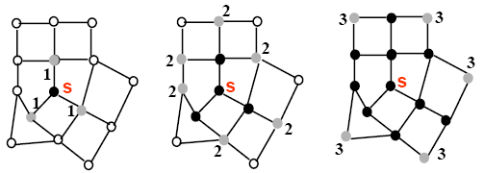
BFS (Intuition)

Slide 36
BFS: The Code
BFS(G, s) {
initialize vertices;
Q = {s};
while (Q not empty) {
u = Dequeue(Q);
for each v adjacent to u do {
if (color[v] == WHITE) {
color[v] = GRAY;
d[v] = d[u] + 1;// compute d[]
p[v] = u; // build BFS tree
Enqueue(Q, v);
}
}
color[u] = BLACK;
}
}

Slide 37
Breadth-First Search: Properties
What do we get the end of BFS?
d[v] = shortest-path distance from s to v, i.e. minimum number of edges from s to v, or ∞ if v not reachable from s
a breadth-first tree, in which path from root s to any vertex v represent a shortest path
Thus can use BFS to calculate shortest path from one vertex to another in O(n+e) time, for unweighted graphs.

Slide 38
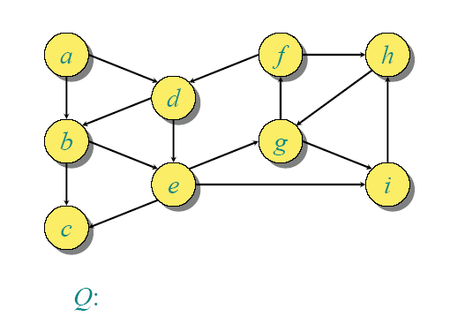
BFS Example

Slide 39
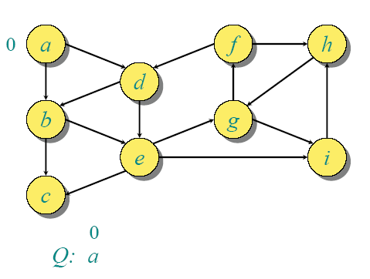
BFS Example

Slide 40
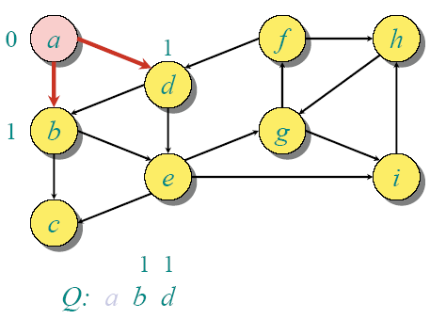
BFS Example

Slide 41
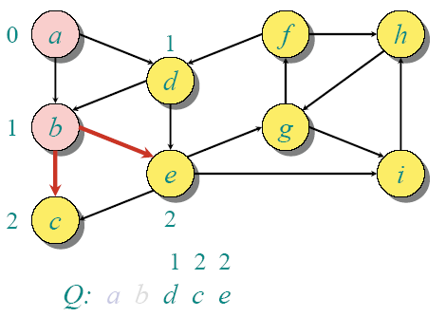
BFS Example

Slide 42
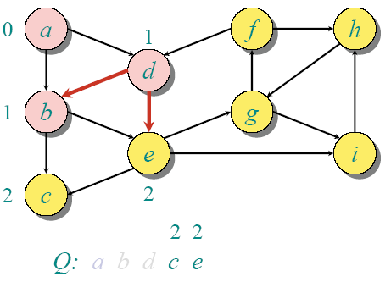
BFS Example

Slide 43
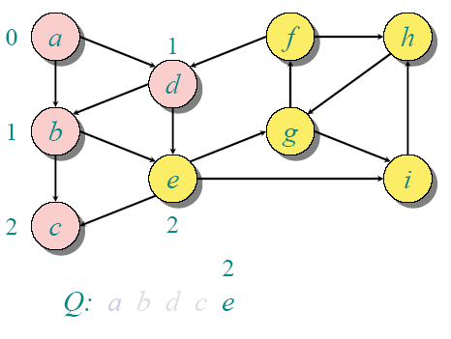
BFS Example

Slide 44
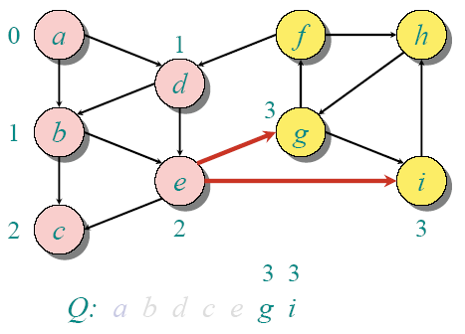
BFS Example

Slide 45
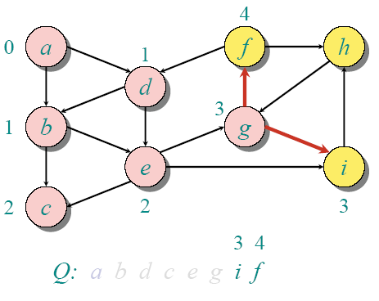
BFS Example

Slide 46
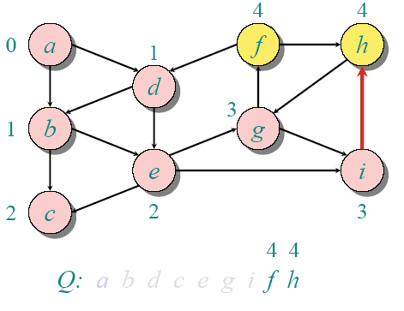
BFS Example

Slide 47
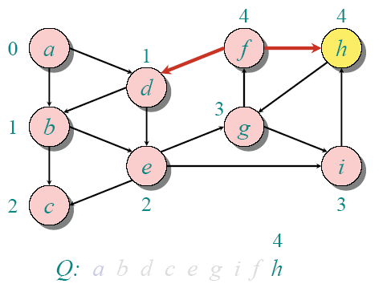
BFS Example

Slide 48
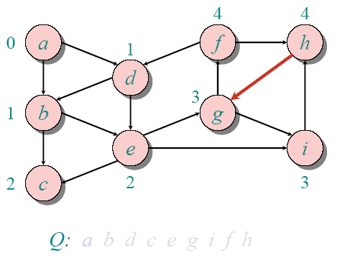
BFS Example

Slide 49
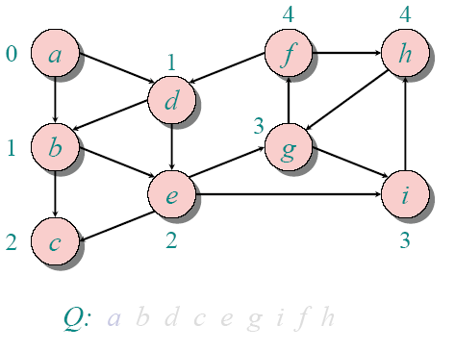
BFS Example

